Slide 1
CIS Hackathon
Code4tomorrow
Abhiram A , Abhirami B M, K S Adithyan, Lakshmi Sarma S

Slide 2
Learnityourway.com
The digital revolution in higher education has happened.
The COVID-19 has resulted in schools shut all across the world. Globally, over 1.2 billion children are out of the classroom.
As a result, education has changed dramatically, with the distinctive rise of e-learning, whereby teaching is undertaken remotely and on digital platforms.
Online Teaching Is No More an Option, It Is a Necessity.

Slide 3

Statistical report of past few months shows that there is a huge rise in students getting enrolled in various online platforms.
Educators will play a key role in the immediate future, not just in helping students adjust to the technological demands of distance learning, but in acting as advocates for expanding online learning opportunities to reach more students.

Slide 4
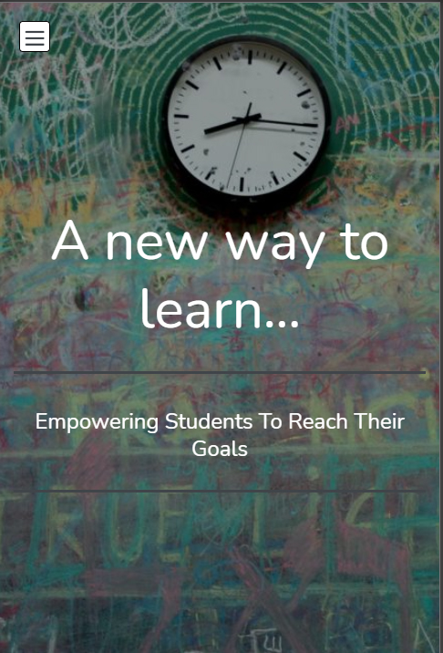
What is learnityourway.com?
Learnityourway.com is an online platform to discover and enhance new skills.
It offers a wide variety of highly adaptive, engaging, and effective learning programs for students.
It is a step towards empowering students to learn more

Slide 5

Explore learnityourway.com
learnityourwaycom1.bookmark.com

Slide 6
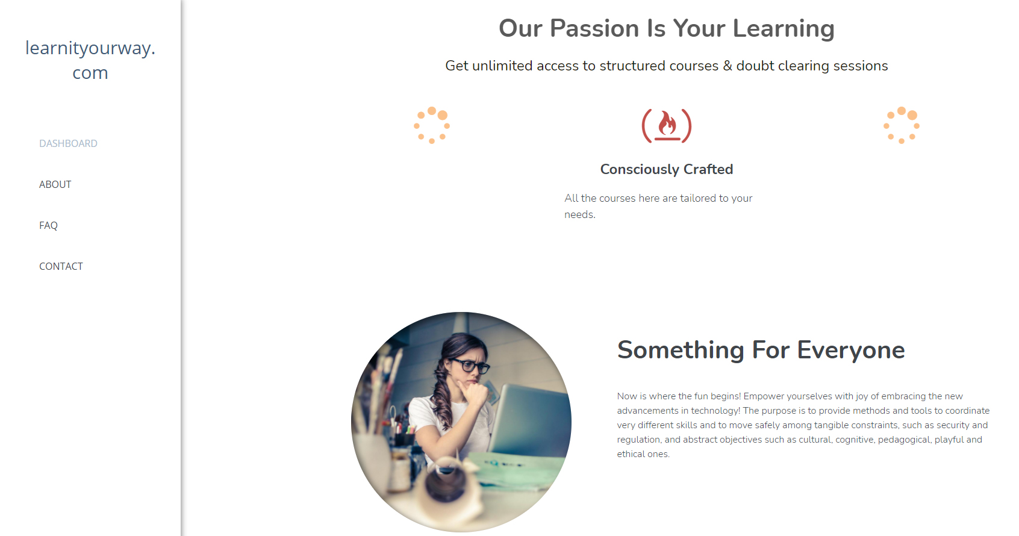

Slide 7
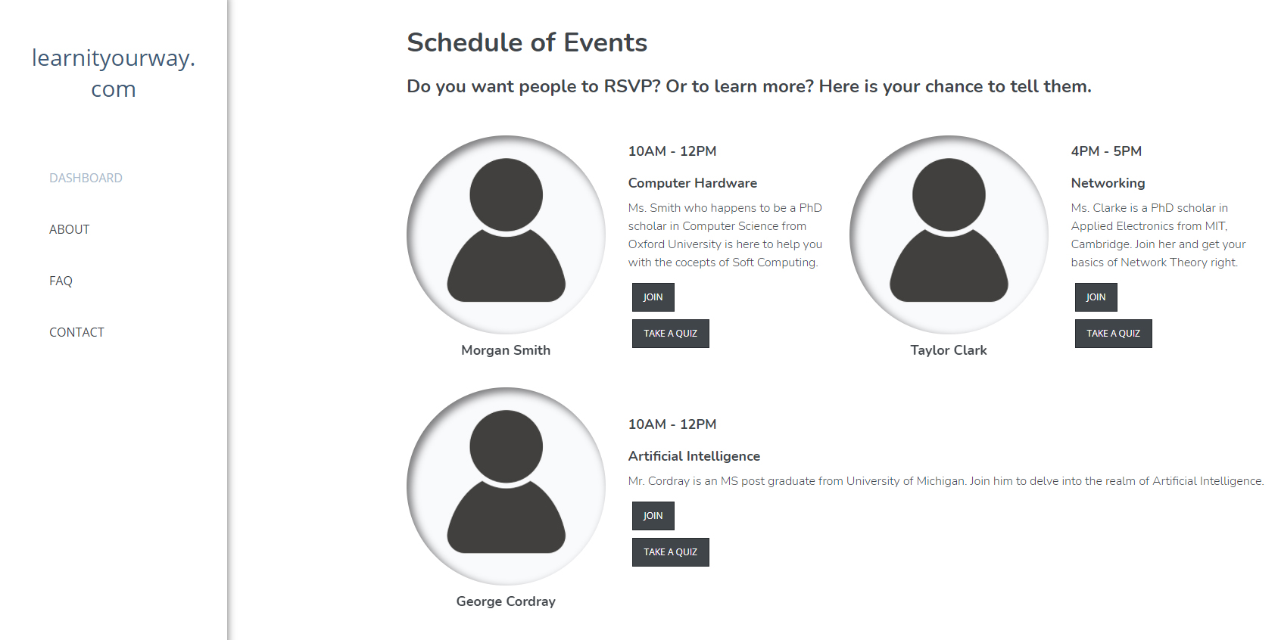

Slide 8
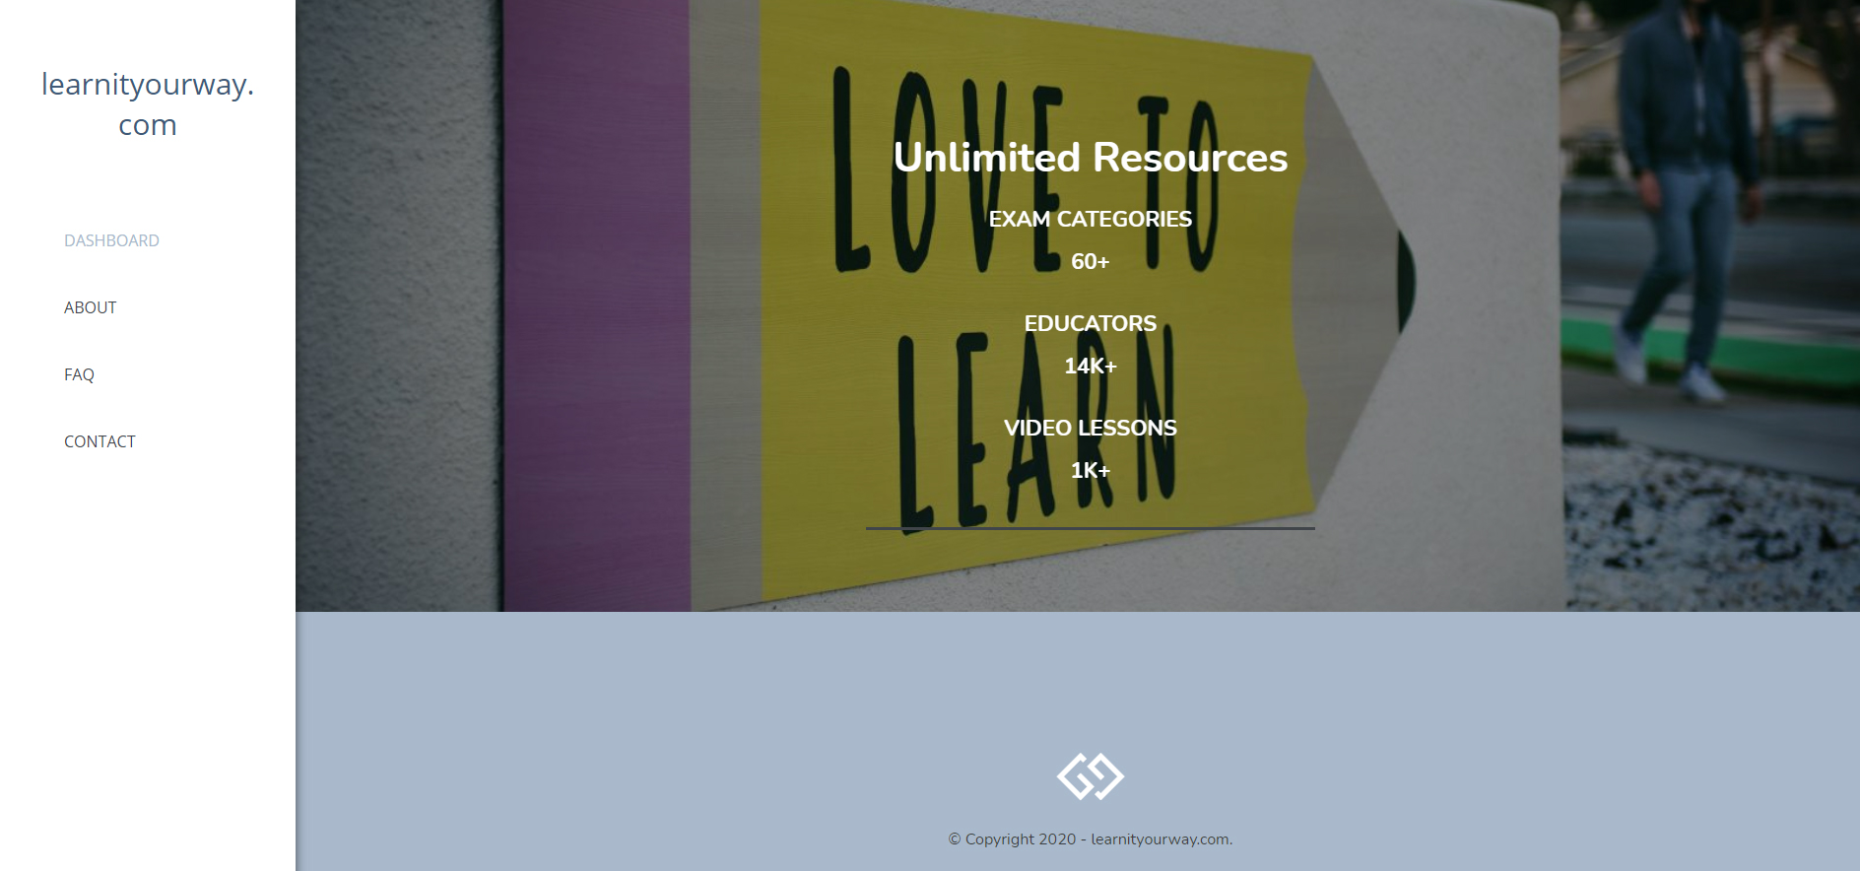

Slide 9
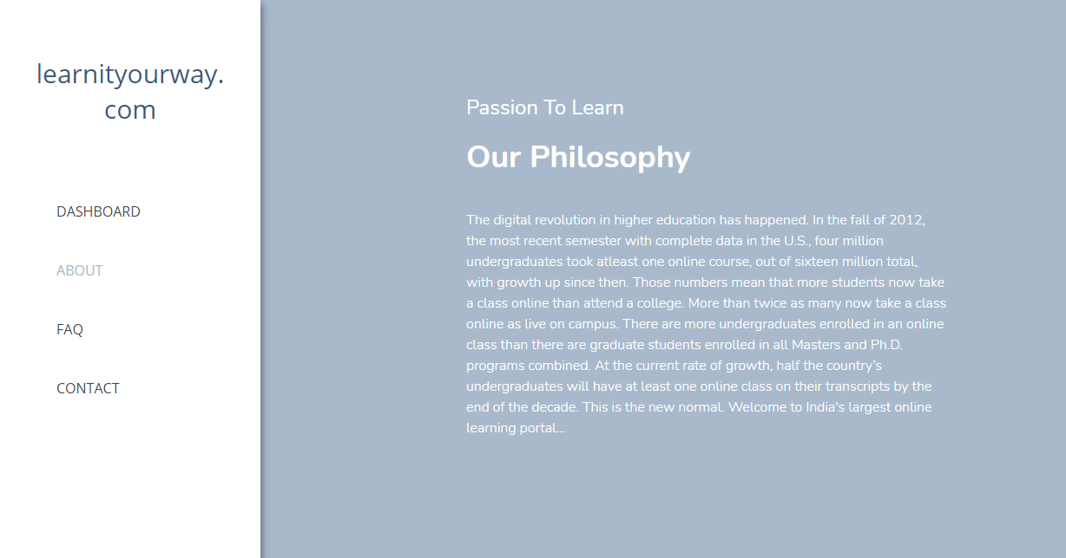

Slide 10
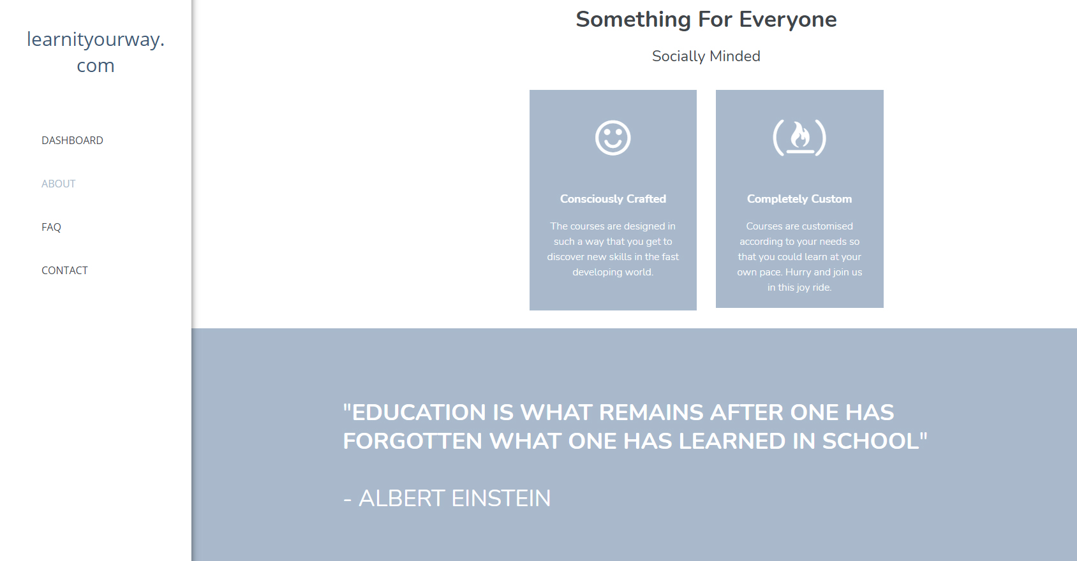

Slide 11
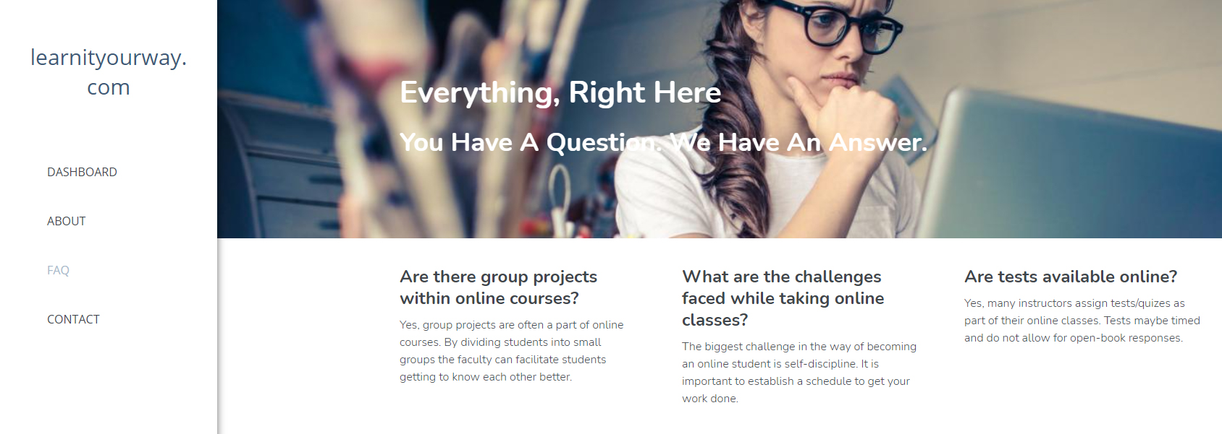

Slide 12
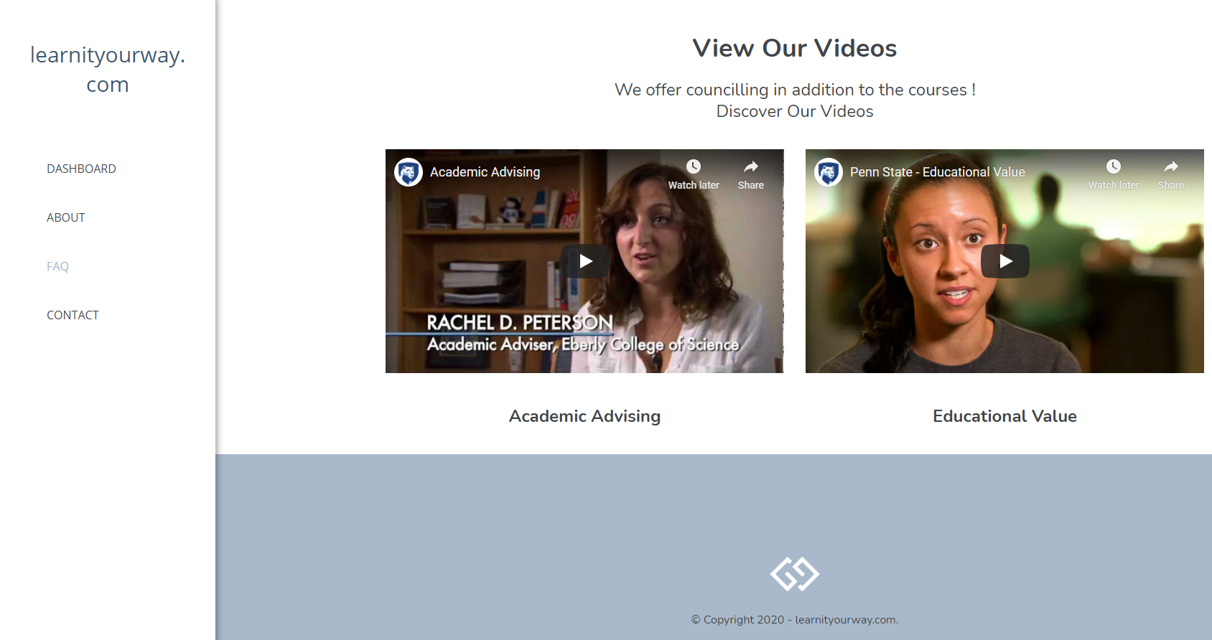

Slide 13
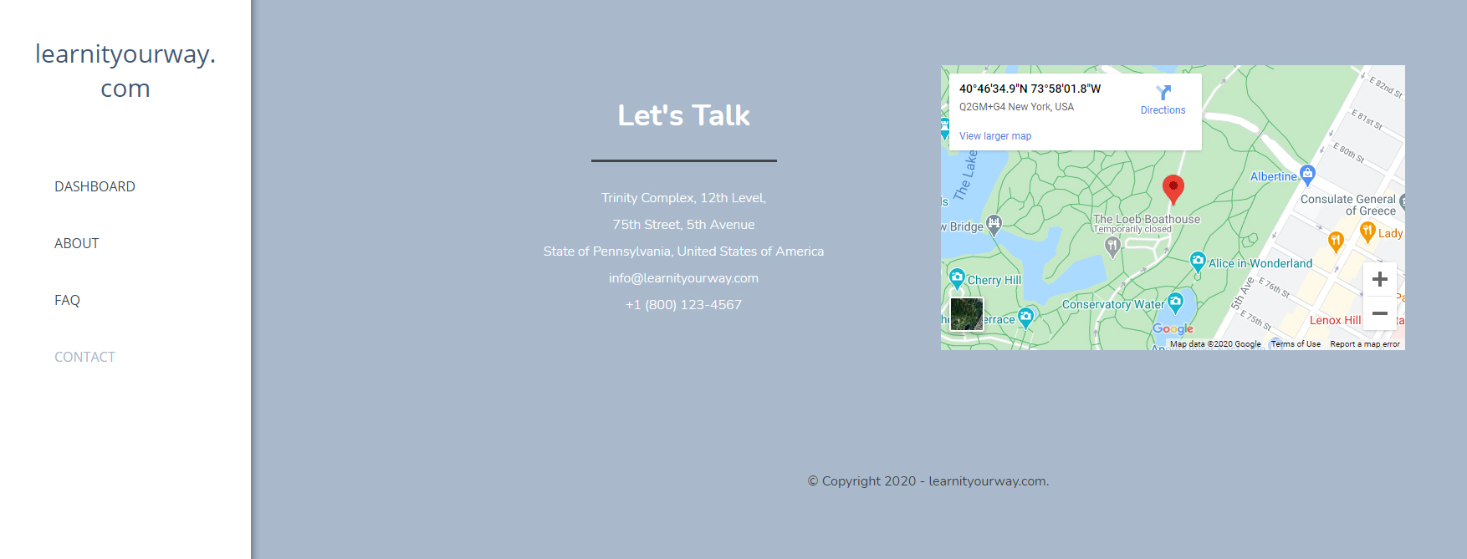

Slide 14
Thank you

